Slide 1
Association as Choice:
What Metacognitive Judgments Tell Us about the Associative Processor
William S. Maki
University of Arizona
Erin Buchanan
Missouri State University
Paper presented at the
Psychonomic Society meeting,
St. Louis
November 20, 2010

Slide 2
Organization of this talk
1. Background on associative measurements
2. Phenomena of interest
3. Application of choice model
4. A possible characteristic of an associative processor

Slide 3
1. Background on associative measurements
2. Phenomena of interest
3. Application of choice model
4. A possible characteristic of an associative processor

Slide 4
The free association task
Please write the first word that comes to your mind in response to each of the following words:
LOST | ____________
OLD | ____________
WORLD | ____________
ELECTION | ____________

Slide 5
The word association norms
Nelson, McEvoy, & Schreiber, 2004
> 5,000 cues
> 72,000 cue-response pairs
~ 150 Ss per pair
p(response | cue) → forward strength (FSG)
  CANARY → BIRD
p(cue | response) → backward strength (BSG)
  BIRD→ CANARY

Slide 6
The associative judgment task
Assume 100 college students from around the nation gave responses to each CUE word. How many of these 100 students do you think would have given the RESPONSE word?
CUE | RESPONSE | N (0 – 100)
LAMP | LIGHT | ______
FIND | SEEK | ______
ELECTION | DISGUST | ______

Slide 7
1. Background on associative measurements
2. Phenomena of interest
3. Application of choice model
4. A possible characteristic of an associative processor

Slide 8
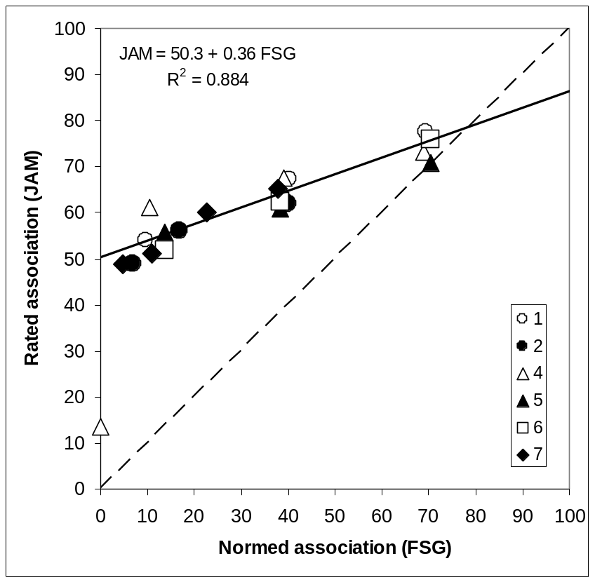
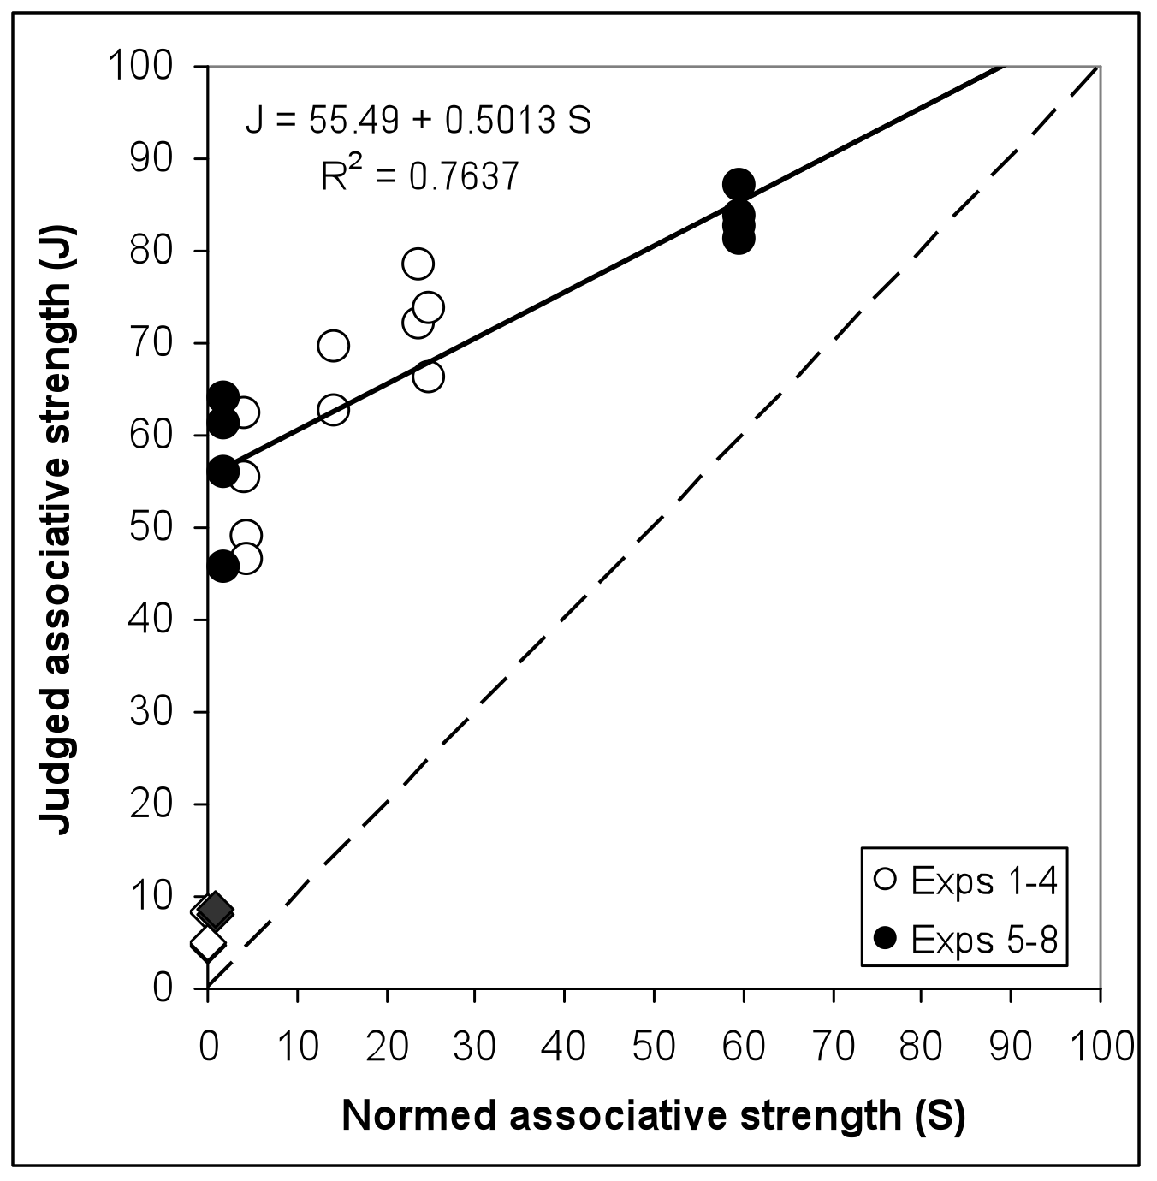
The JAM function (Judging Associative Memory):
An operating characteristic for associative processing
(Maki, 2007a; Koriat, Fiedler, & Bjork, 2006)

Slide 9
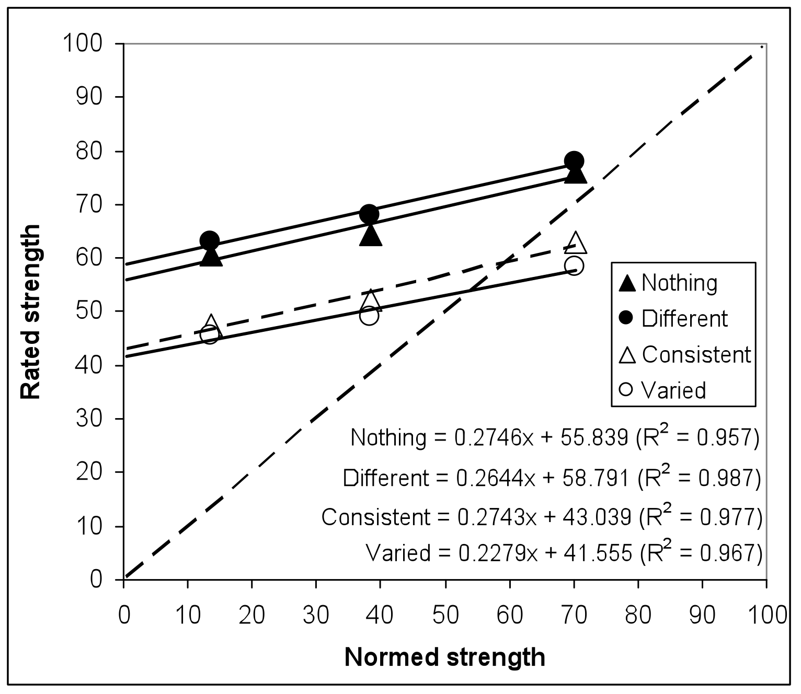
Error correction experiment:
Transfer results

Slide 10
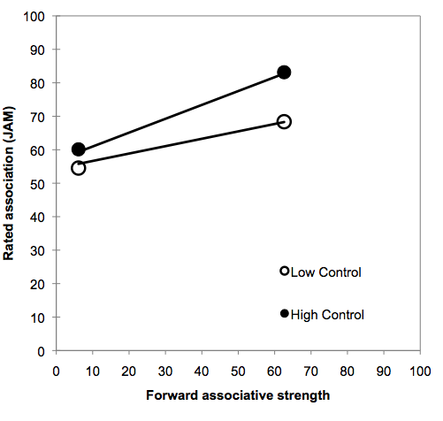
Interaction of forward and backward strengths

Slide 11
1. Background on associative measurements
2. Phenomena of interest
3. Application of choice model
4. A possible characteristic of an associative processor

Slide 12
Association as choice
Free association is analogous to other choices
  Independent from irrelevant alternatives
    Respond to CANARY, not TRUCK
  Set is finite, mutually exclusive, and exhaustive
  Objects are represented by identical but independent distributions
Mathematics of choice can then be applied
  Yellott, JMP, 1977

Slide 13
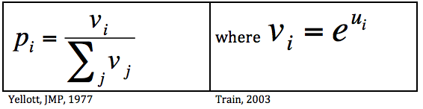
Application of choice model (Luce) to free association

Slide 14
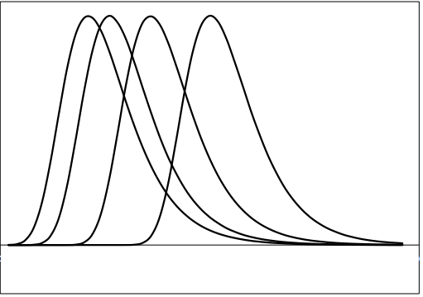
Computing offset values
Adjust means of distributions
  double exponentials
Draw random samples for p(FA)
Compute error
Yellott, JMP, 1977.
Nelson, McEvoy, & Dennis, M&C, 2000.
Associates of CANARY:
  Bird, Yellow, Sing, Song

Slide 15
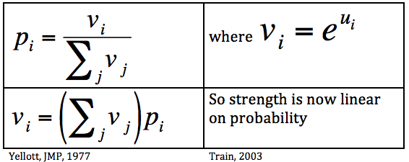
Application of choice model to associative judgments

Slide 16
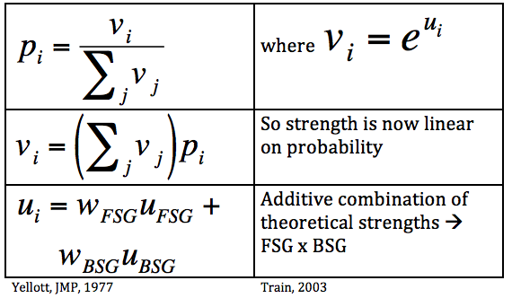
Application of choice model to associative judgments

Slide 17
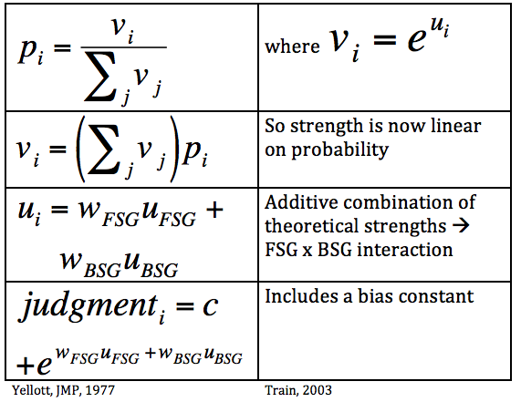
Application of choice model to free association and associative judgments

Slide 18
1. Background on associative measurements
2. Phenomena of interest
3. Application of choice model
4. A possible characteristic of an associative processor

Slide 19
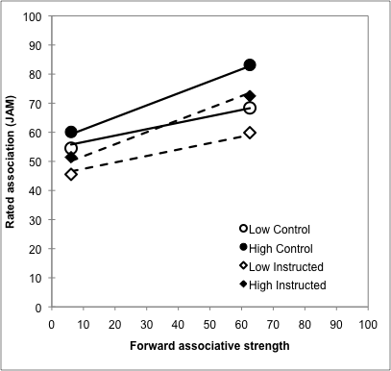
Does theory-based debiasing alter JAM?
(Koriat & Bjork; Maki & Buchanan)
Control
  Standard JAM instructions
  Replicate FSG x BSG
Instructed
  Debiasing instructions
  Informed about BSG
  Attend only to FSG
Instructions reduce bias …
… but do not modulate associative processing.

Slide 20
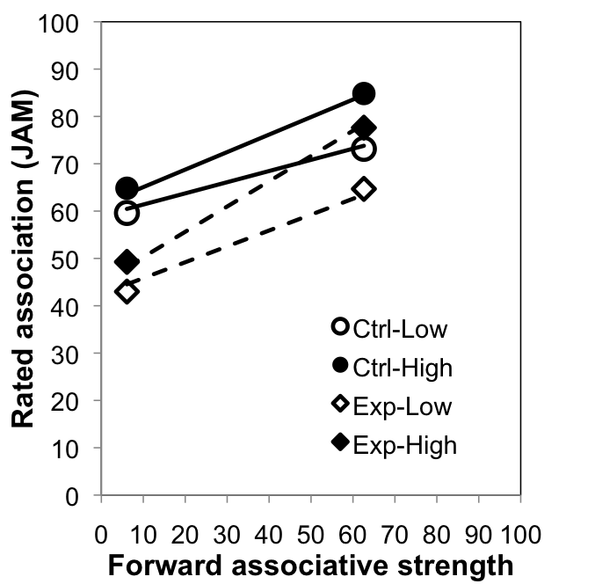
Effects of theory-based debiasing with error correction
Control group given standard JAM instructions
Experimental group given debiasing instructions supplemented by error correction examples
More potent manipulation lowered intercept AND increased slope …
… but FSG x BSG interaction still present.
Model fit with common w_{BSG}
Alternative explanations
  Why selective effect on FSG?
  Effect mediated by deliberative processing?

Slide 21

Conclusions
Associative judgments based on a source of bias and the results of associative processing.
The “associative processor” combines forward and backward strengths such that judgments of FSG are amplified by BSG.
Associative combination appears impervious to debiasing treatments.
  Cognitively impenetrable ???

Slide 22
That’s all …
Thanks for your attention !
Acknowledgements
  Doug Nelson & Cathy McEvoy (for their association norms)
  Robert Nosofsky (for relating the Nelson-McEvoy-Dennis model to RUMs)

